Slide 1
Portada
Notes:
textbox
No alt text provided.
image
No alt text provided.
textbox
No alt text provided.
textbox
No alt text provided.
textbox
No alt text provided.

Slide 2
Introducción
Notes:
textbox
No alt text provided.
textbox
No alt text provided.
image
No alt text provided.

Slide 3
Metodología
Notes:
textbox
No alt text provided.
image
1. Informes de Labores 2. Evaluación del Plan Anual 3. Lista de proyectos de investigación y extensión 4. Documentación sobre Centros de Investigación 6. Correo electrónico 7. Página Web, 8. Matriz de información 9. Validación con 217 personas
image
No alt text provided.

Slide 4
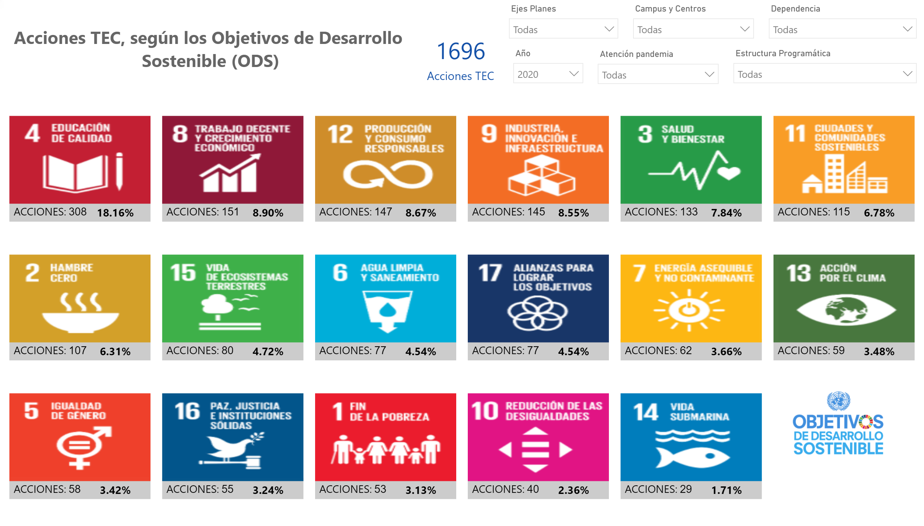
Objetivos
Notes:
PBI_CV_73744D90_4DC9_4F18_8BA5_EE8FA5C98035
No alt text provided.
slicer
No alt text provided.
slicer
No alt text provided.
textbox
No alt text provided.
card
No alt text provided.
image
No alt text provided.
slicer
No alt text provided.
slicer
No alt text provided.
slicer
No alt text provided.
slicer
No alt text provided.

Slide 5
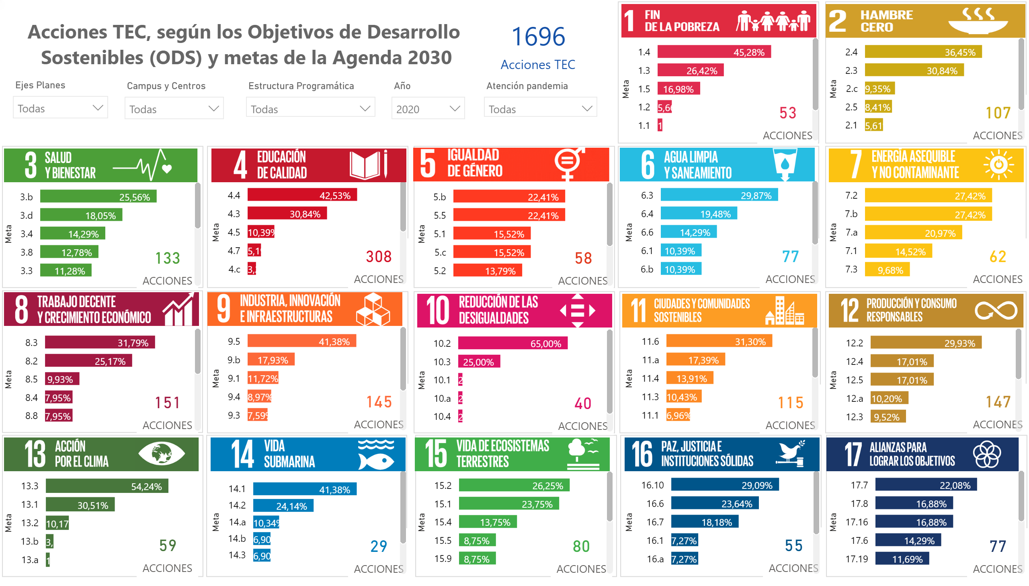
Metas
Notes:
basicShape
No alt text provided.
basicShape
No alt text provided.
basicShape
No alt text provided.
basicShape
No alt text provided.
basicShape
No alt text provided.
basicShape
No alt text provided.
basicShape
No alt text provided.
basicShape
No alt text provided.
basicShape
No alt text provided.
basicShape
No alt text provided.
basicShape
No alt text provided.
basicShape
No alt text provided.
basicShape
No alt text provided.
basicShape
No alt text provided.
basicShape
No alt text provided.
basicShape
No alt text provided.
basicShape
No alt text provided.
clusteredBarChart
No alt text provided.
card
No alt text provided.
clusteredBarChart
No alt text provided.
card
No alt text provided.
image
Objetivo 1. Fin de la pobreza
image
Objetivo 2. Hambre cero
clusteredBarChart
No alt text provided.
clusteredBarChart
No alt text provided.
clusteredBarChart
No alt text provided.
clusteredBarChart
No alt text provided.
clusteredBarChart
No alt text provided.
clusteredBarChart
No alt text provided.
clusteredBarChart
No alt text provided.
clusteredBarChart
No alt text provided.
clusteredBarChart
No alt text provided.
clusteredBarChart
No alt text provided.
clusteredBarChart
No alt text provided.
clusteredBarChart
No alt text provided.
clusteredBarChart
No alt text provided.
clusteredBarChart
No alt text provided.
clusteredBarChart
No alt text provided.
card
No alt text provided.
card
No alt text provided.
card
No alt text provided.
card
No alt text provided.
card
No alt text provided.
card
No alt text provided.
card
No alt text provided.
card
No alt text provided.
card
No alt text provided.
card
No alt text provided.
card
No alt text provided.
card
No alt text provided.
card
No alt text provided.
card
No alt text provided.
card
No alt text provided.
image
Objetivo 3. Salud y Bienestar
image
Objetivo 4. Educación de calidad
image
Objetivo 6. Agua y saneamiento
image
Objetivo 7. Energía Asequible y no contaminante
image
Objetivo 8. Trabajo decente y crecimiento económico
image
Objetivo 9. Industria, innovación e infraestructuras
image
Objetivo 10. Reducción de las desigualdades
image
Objetivo 11. Ciudades y Comunidades Sostenibles
image
Objetivo 12. Producción y consumo responsables
image
Objetivo 13. Acción por el clima
image
Objetivo 14. Vida Submarina
image
Objetivo 15. Vida de ecosistemas terrestres
image
Objetivo 16. Paz, husticia e instituciones sólidas
image
Objetivo 17. Alianzas para lograr los objetivos
textbox
No alt text provided.
image
Objetivo 5. Igualdad de género
card
No alt text provided.
slicer
No alt text provided.
slicer
No alt text provided.
slicer
No alt text provided.
slicer
No alt text provided.
slicer
No alt text provided.

Slide 6
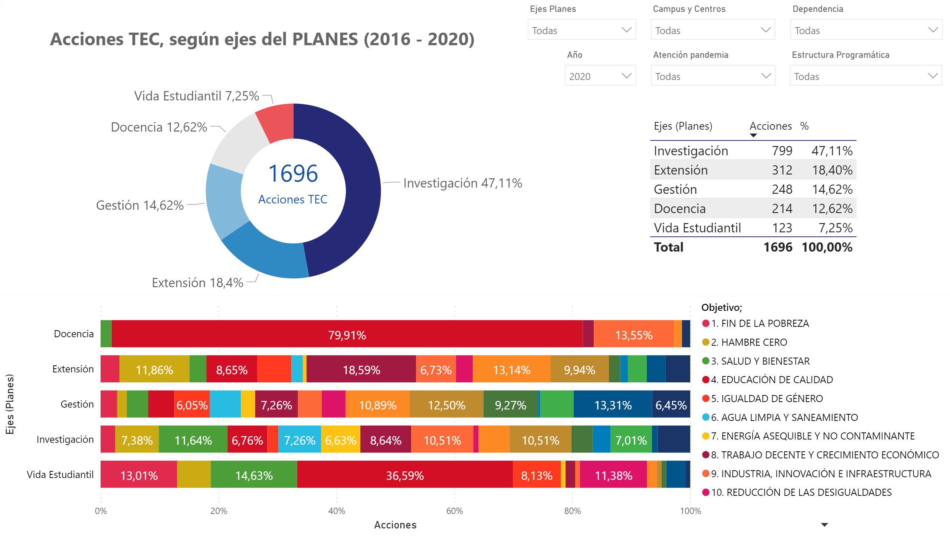
Eje (PLANES)
Notes:
donutChart
No alt text provided.
tableEx
No alt text provided.
hundredPercentStackedBarChart
No alt text provided.
textbox
No alt text provided.
card
No alt text provided.
slicer
No alt text provided.
slicer
No alt text provided.
slicer
No alt text provided.
slicer
No alt text provided.
slicer
No alt text provided.
slicer
No alt text provided.

Slide 7
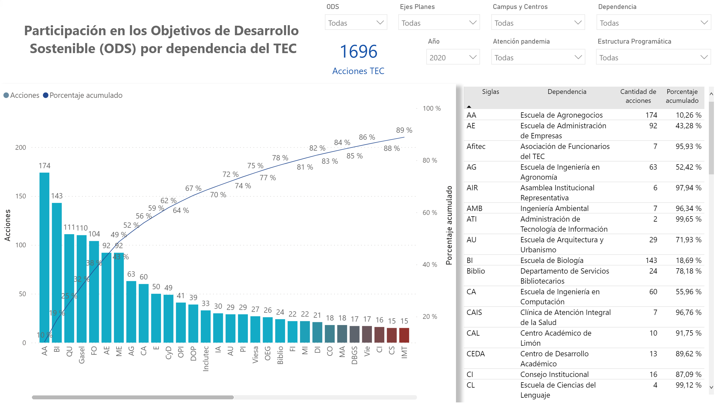
Dependencias ITCR
Notes:
textbox
No alt text provided.
card
No alt text provided.
lineClusteredColumnComboChart
No alt text provided.
slicer
No alt text provided.
tableEx
No alt text provided.
slicer
No alt text provided.
slicer
No alt text provided.
slicer
No alt text provided.
slicer
No alt text provided.
slicer
No alt text provided.
slicer
No alt text provided.

Slide 8
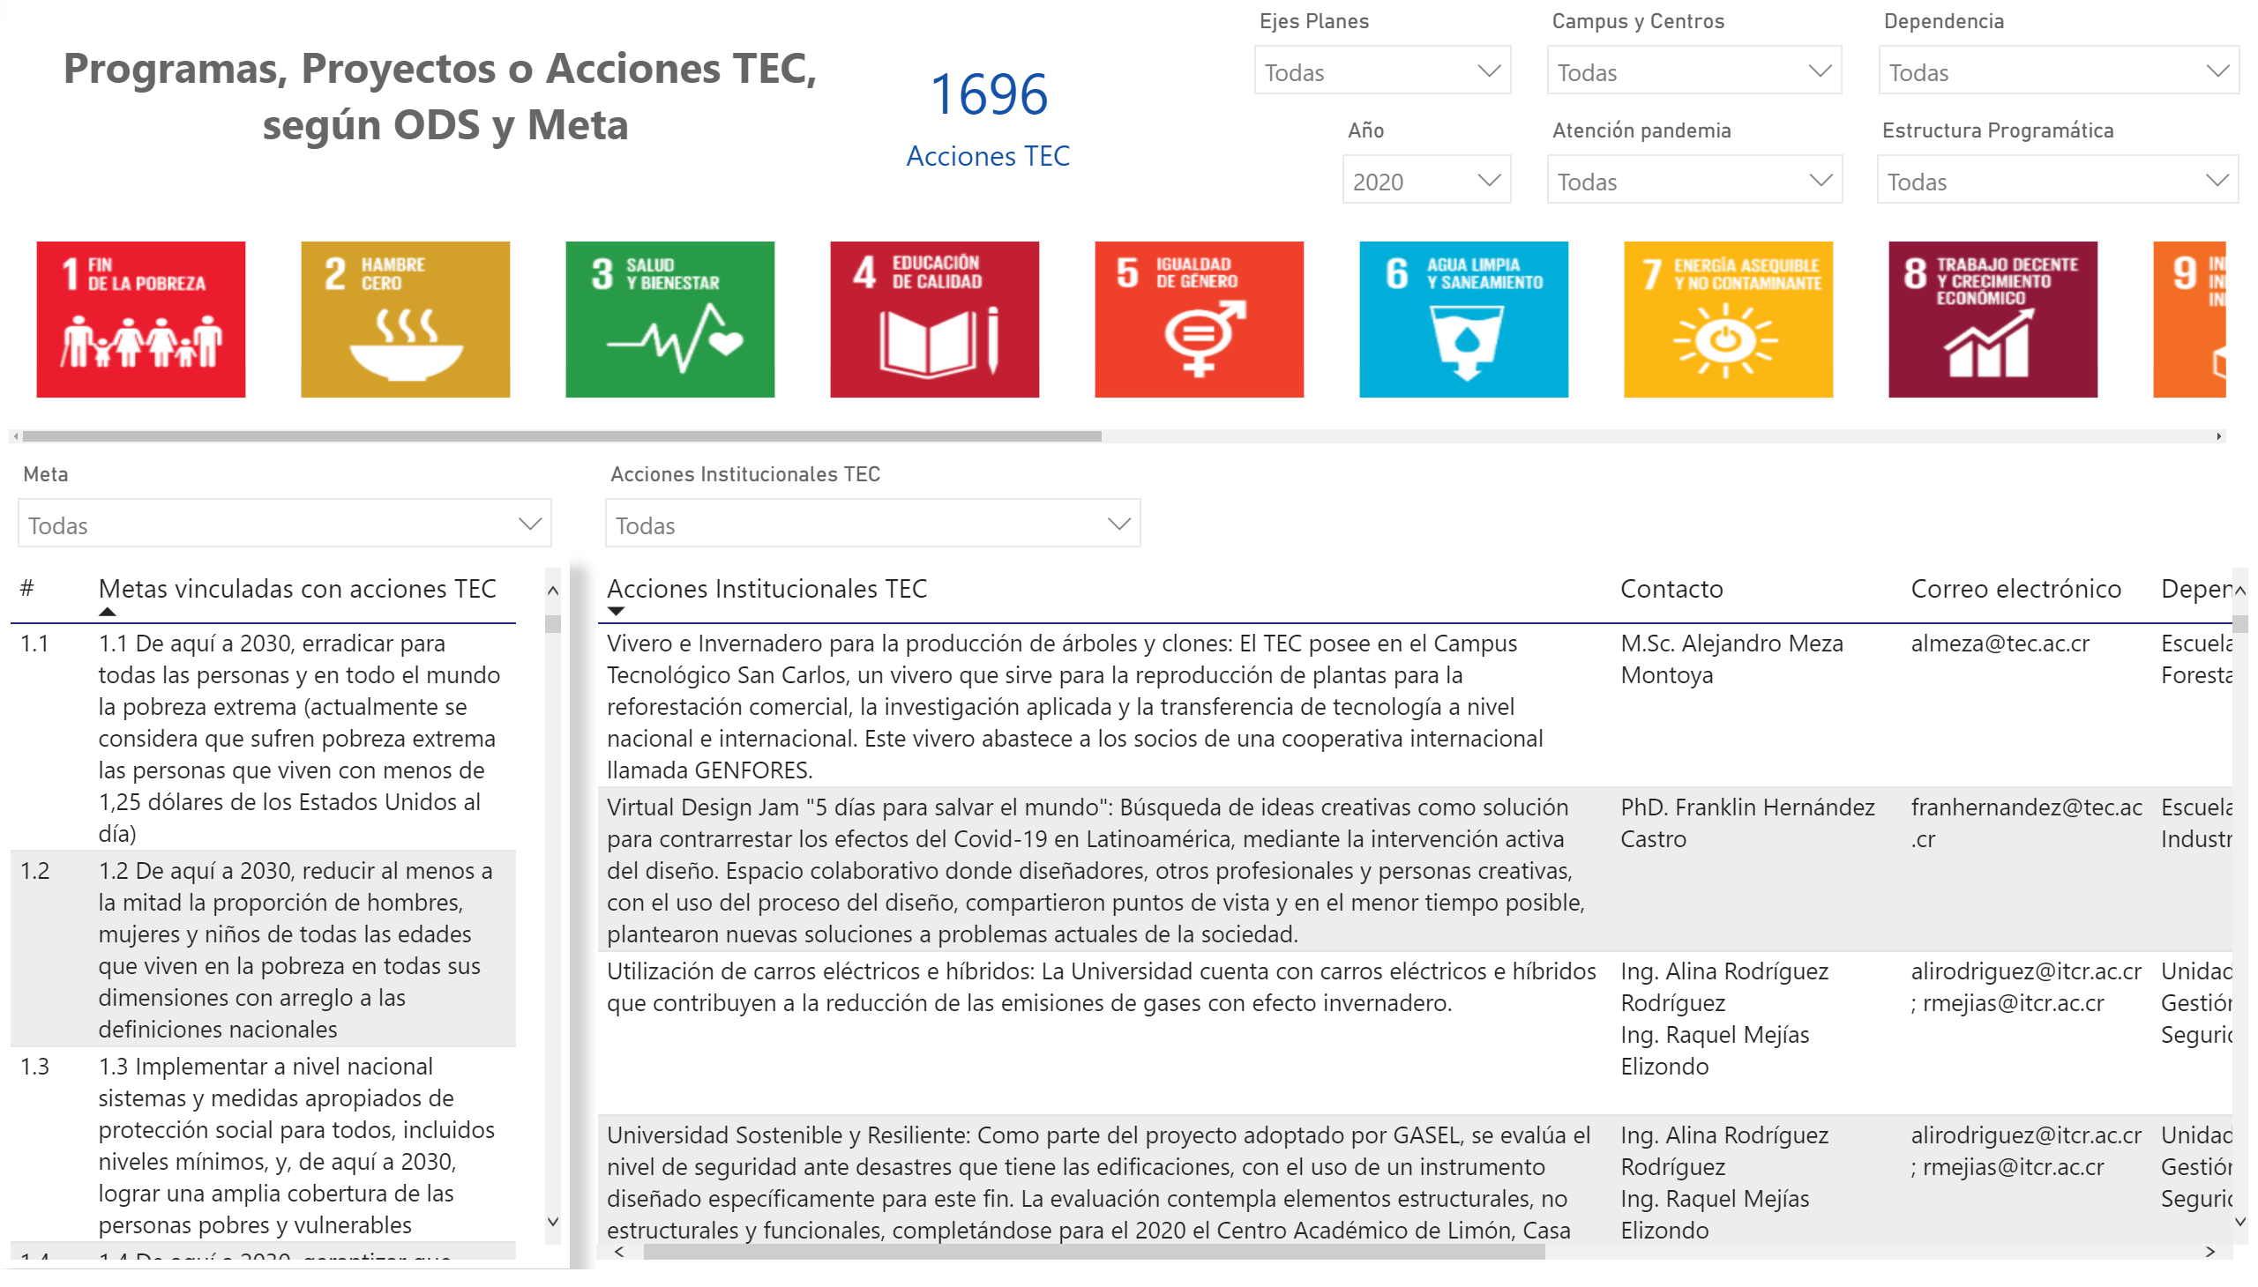
Acciones realizadas
Notes:
tableEx
No alt text provided.
tableEx
No alt text provided.
PBI_CV_73744D90_4DC9_4F18_8BA5_EE8FA5C98035
No alt text provided.
textbox
No alt text provided.
card
No alt text provided.
slicer
No alt text provided.
slicer
No alt text provided.
slicer
No alt text provided.
slicer
No alt text provided.
slicer
No alt text provided.
slicer
No alt text provided.
slicer
No alt text provided.
slicer
No alt text provided.

Slide 9
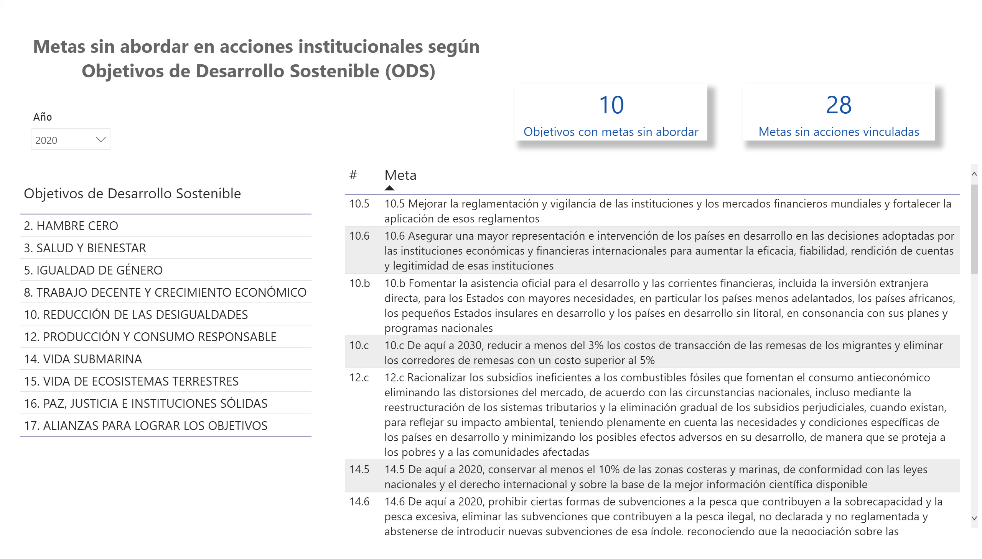
Metas sin abordar
Notes:
tableEx
No alt text provided.
textbox
No alt text provided.
card
No alt text provided.
card
No alt text provided.
tableEx
No alt text provided.
slicer
No alt text provided.

Slide 10
Trabajo actual
Notes:
textbox
No alt text provided.
textbox
No alt text provided.
textbox
No alt text provided.
image
No alt text provided.
image
Objetivos de Desarrollo Sostenible

